Slide 1
Crowd Supply
Course Workbook

Slide 2
Table of Contents
About this Workbook | Slide 3
Pre-Lab: Workshop Pre-requisites | Slide 4
Lab : Implementing the Vivado Design | Slide 7

Slide 3
About this Workbook
This workbook is designed to be used in conjunction with the Crowd Supply lab one workshop.
The contents of this workbook are created by Adiuvo Engineering & Training, Ltd.
If you have any questions about the contents, or need assistance, please contact Adam Taylor at adam@adiuvoengineering.com.

Slide 4
Pre-Lab Workshop Pre-requisites

Slide 5
Required Hardware
Pre-Lab
The following hardware is required to complete this series of labs
Digilent Basys3 Development board

Slide 6
Downloads and Installations
Pre-Lab
Step 1 – Download and install the following at least one day prior to the workshop. This may take a significant amount of time and drive space.
Vitis 2020.2 – Includes Vivado | Download
Source Project Files | Download

Slide 7
Lab Creating Pong on the Basys3

Slide 8
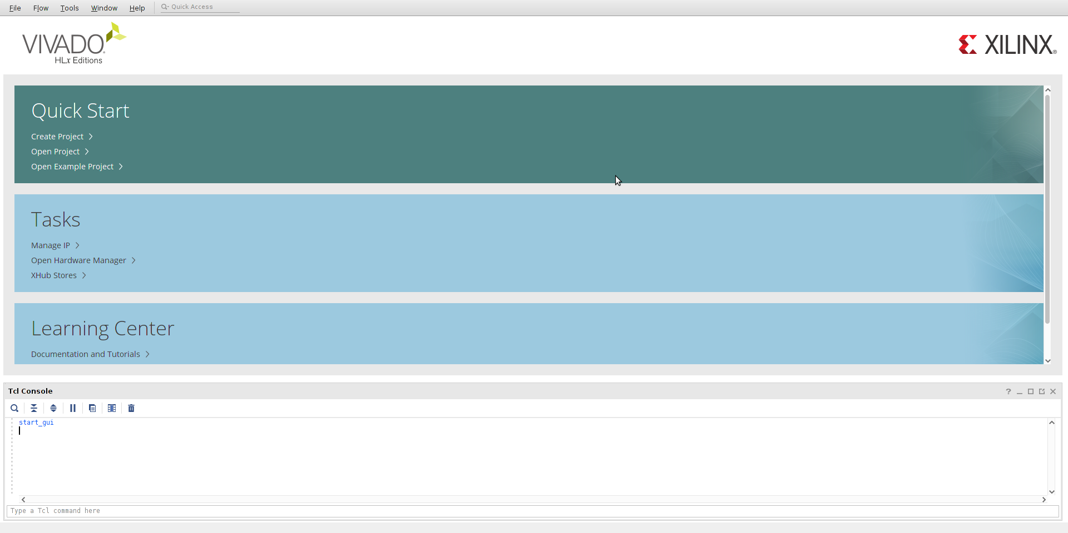
Crowd Supply: Lab One
Lab One
Step 1 – Open Vivado 2020.2. Once Vivado opens, open the Xhub Store

Slide 9
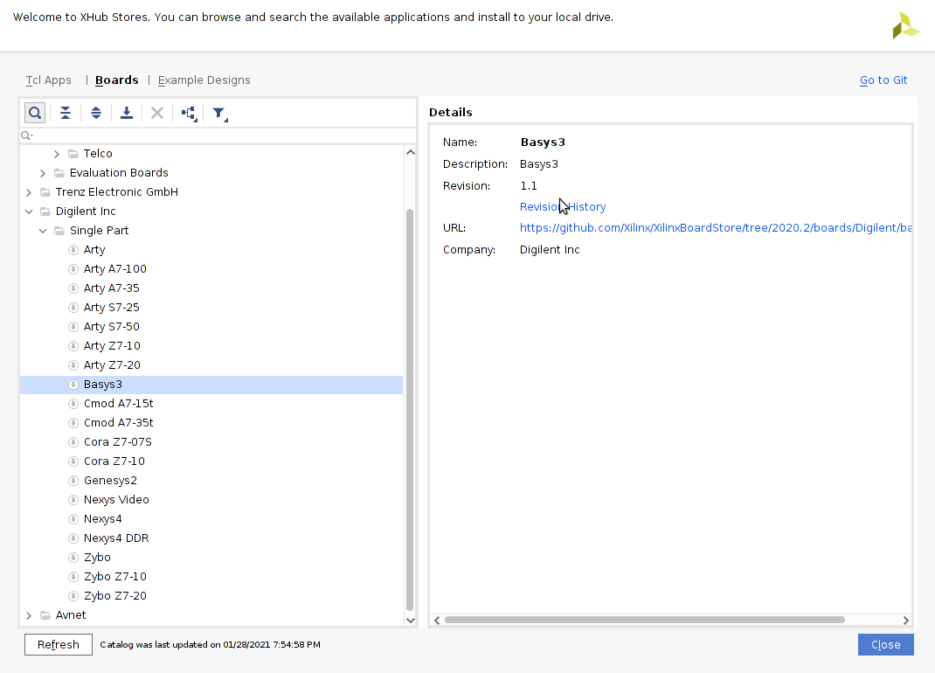
Crowd Supply: Lab One
Lab One
Step 2 – Once the Xhub Stor Opens on the boards tab ensue Basys3 board is installed, right click to install

Slide 10
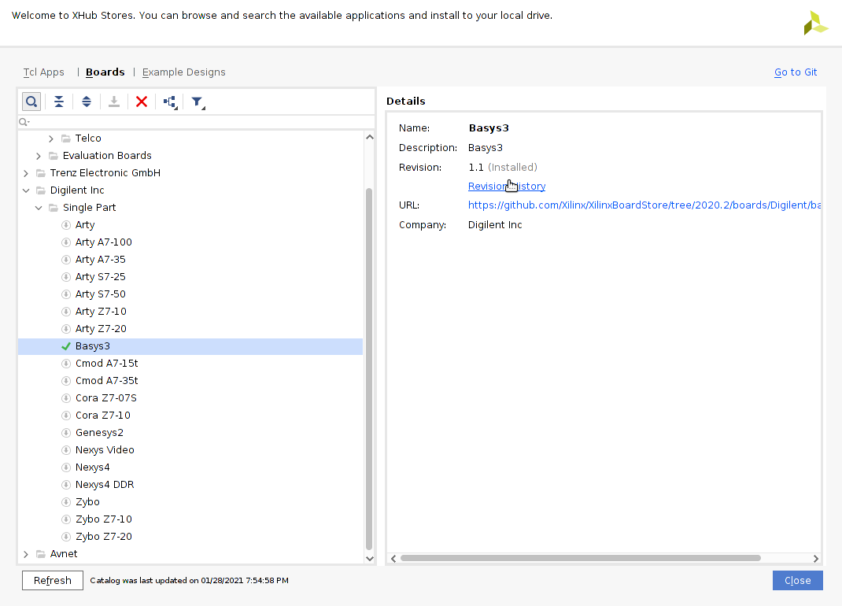
Crowd Supply: Lab One
Lab One
Step 3 – When the Basys3 board is installed a green check will appear next to the board. Click close

Slide 11
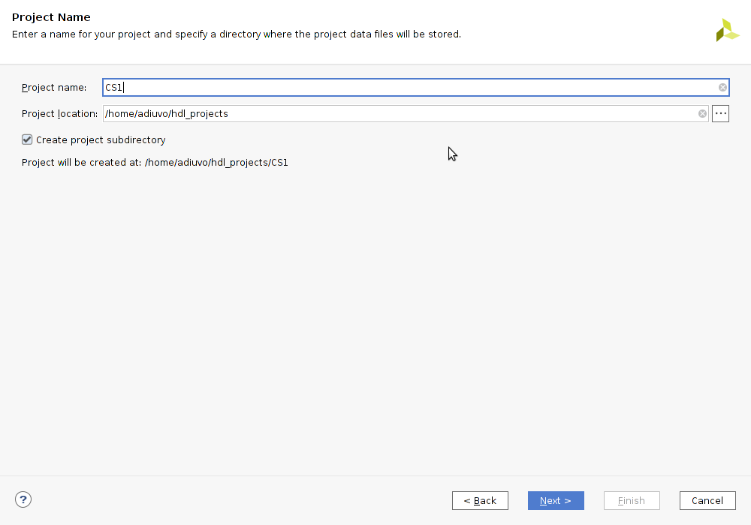
Crowd Supply: Lab One
Lab One
Step 4 – Create a new project, in the dialog which follows enter a Project name and location click next

Slide 12
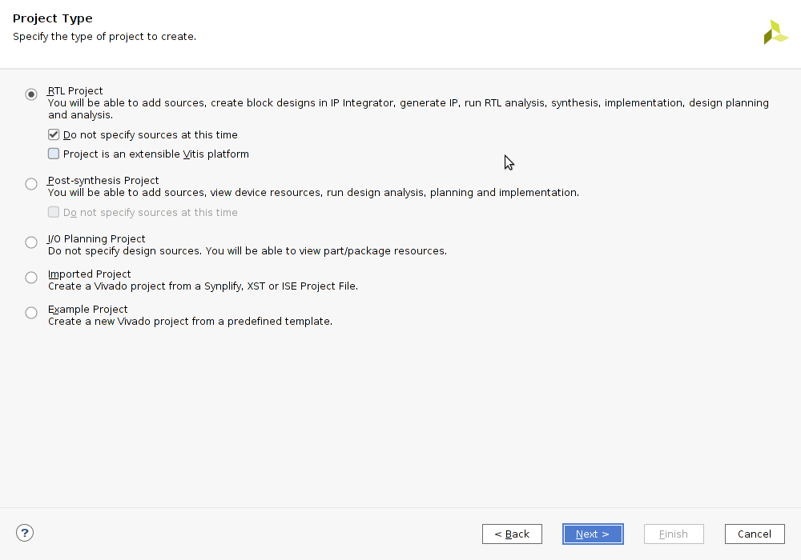
Crowd Supply: Lab One
Lab One
Step 5 – On the next tab, select RTL Project and check “do no specify sources at this time”, click next

Slide 13
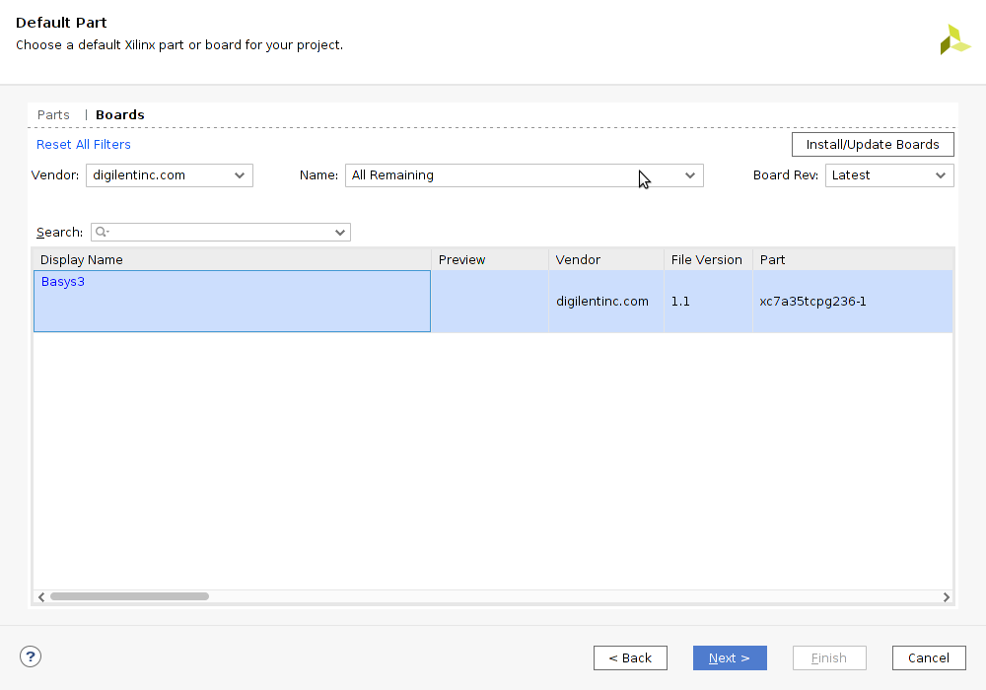
Crowd Supply: Lab One
Lab One
Step 6 – On the next tab select the Basys3 board and click next

Slide 14
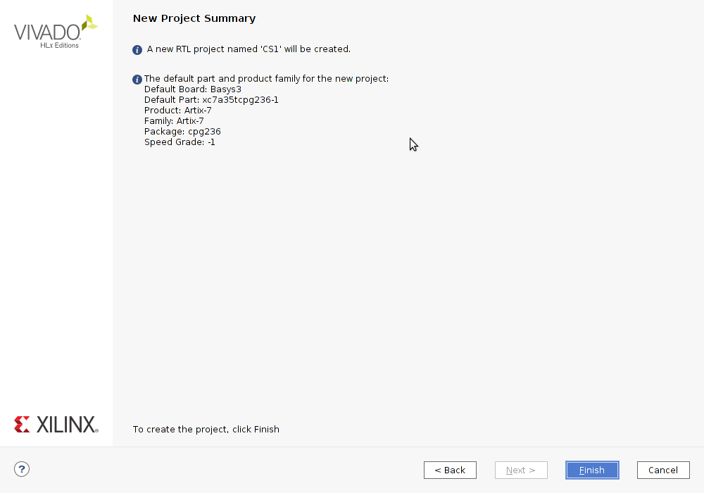
Crowd Supply: Lab One
Lab One
Step 7 – On the project summary page click finish

Slide 15
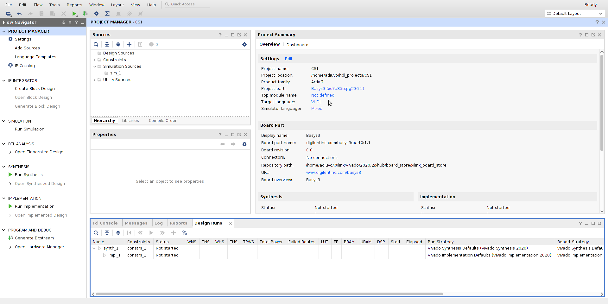
Crowd Supply: Lab One
Lab One
Step 8 – When the project opens from IP Integrator select “Create Block Design”

Slide 16
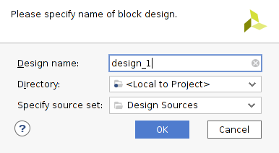
Crowd Supply: Lab One
Lab One
Step 9 – Leave the defaults in the dialog box which appears, click OK

Slide 17
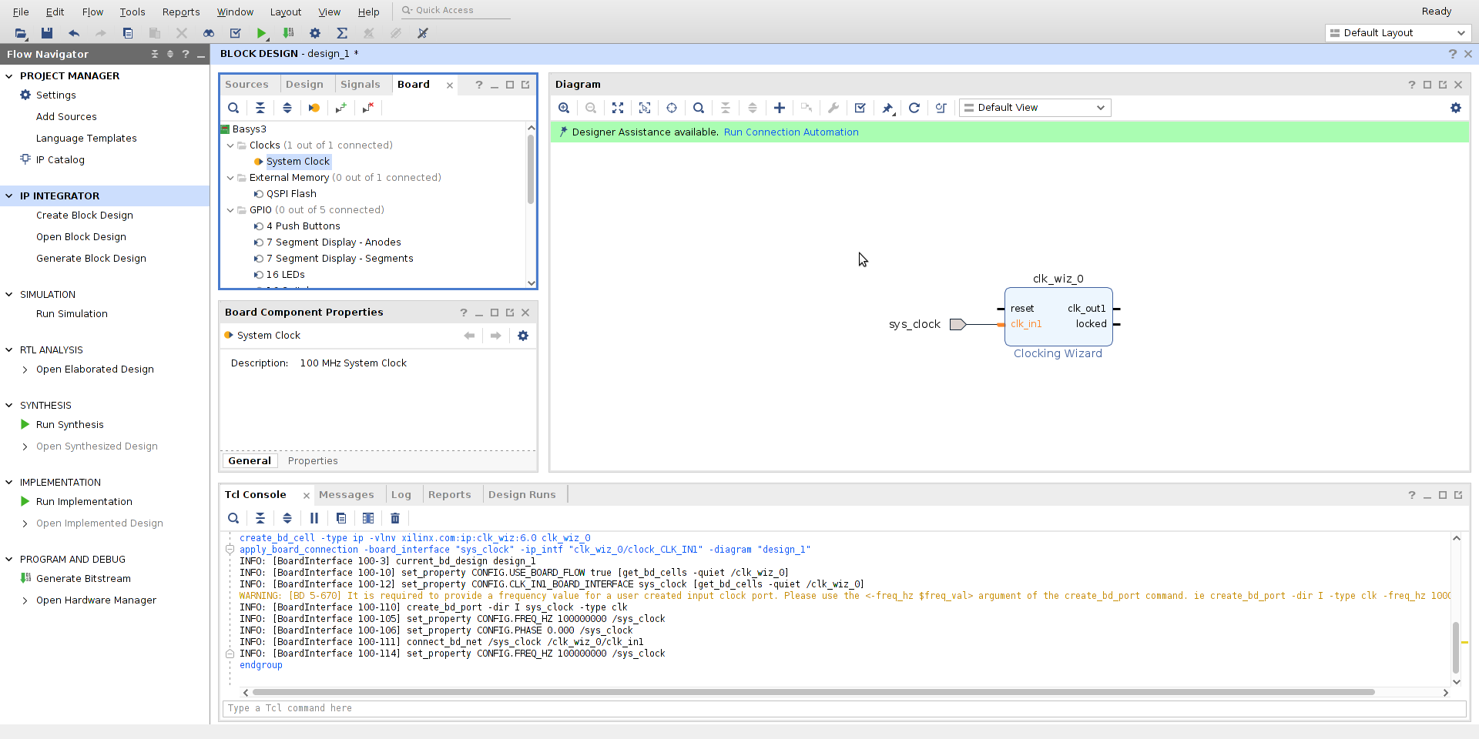
Crowd Supply: Lab One
Lab One
Step 10 – Once the Block Design is created select the board tab and drag the system clock onto the block design

Slide 18
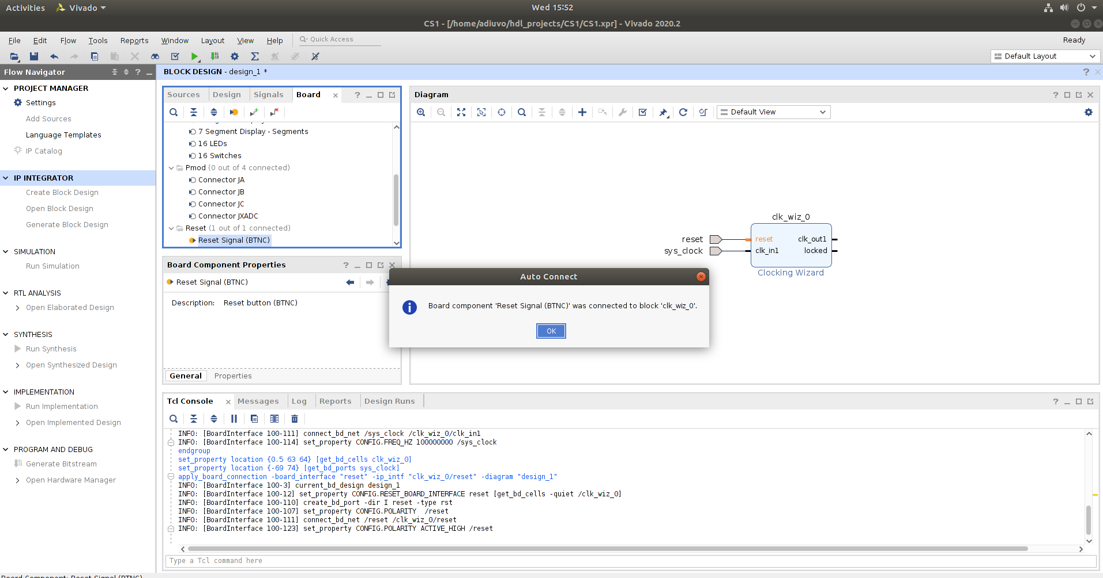
Crowd Supply: Lab One
Lab One
Step 11 – From the board tab drag the Reset signal on to the Clock Wizard Reset Pin

Slide 19
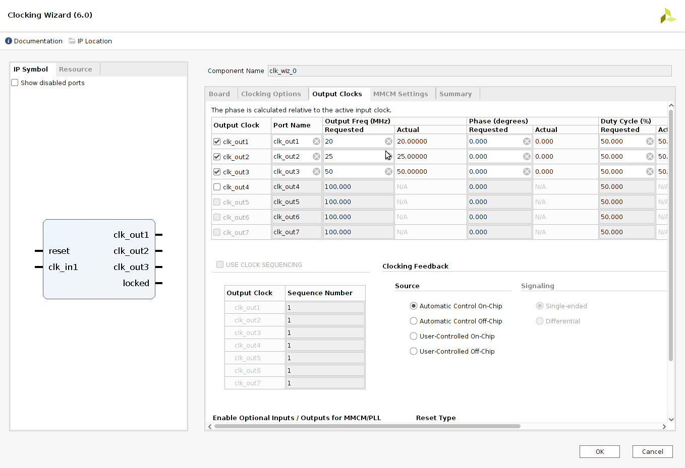
Crowd Supply: Lab One
Lab One
Step 12 – Double click on the clock wizard and select CLK1 = 20 MHz, CLK2 = 25MHz, CLK3 = 50MHz

Slide 20
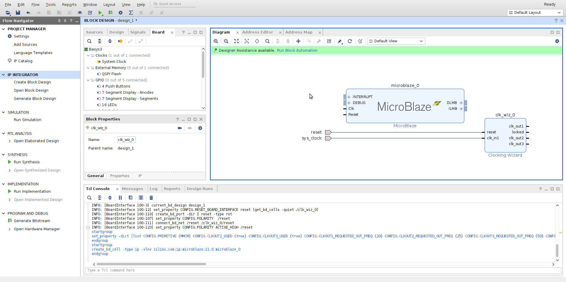
Crowd Supply: Lab One
Lab One
Step 13 – Click on the + symbol and add a MicroBlaze to the block design

Slide 21
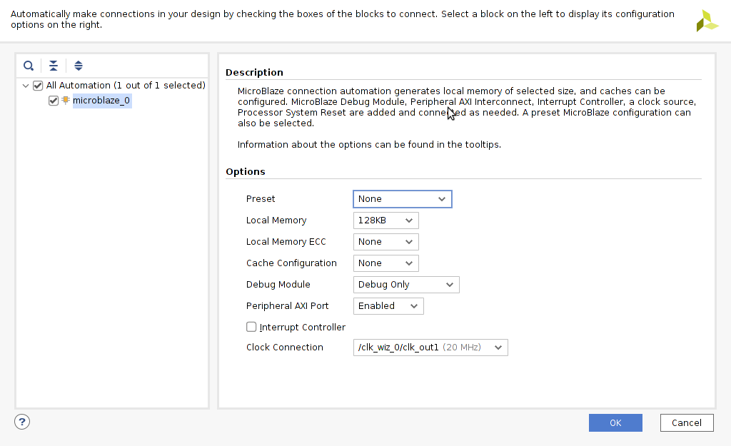
Crowd Supply: Lab One
Lab One
Step 14 – Run the Block Automation and set the local memory to 128KB and ensure the Peripheral AXI Port is enabled

Slide 22
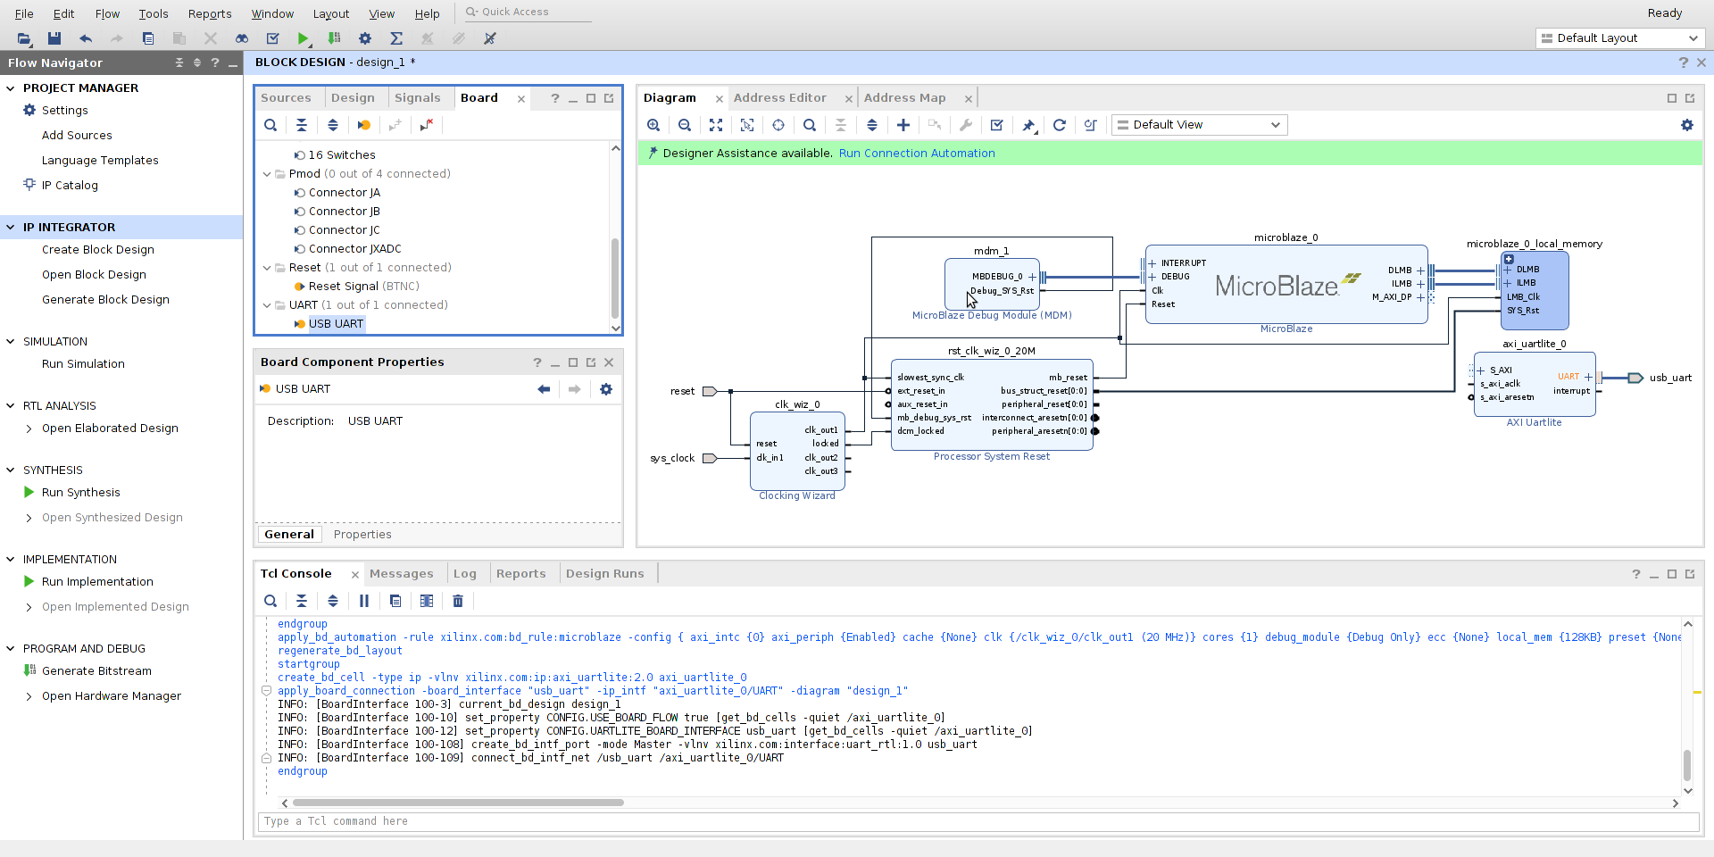
Crowd Supply: Lab One
Lab One
Step 15 – This will create the MicroBlaze System as shown below. From the board tab drag the USB UART on to the block design.

Slide 23
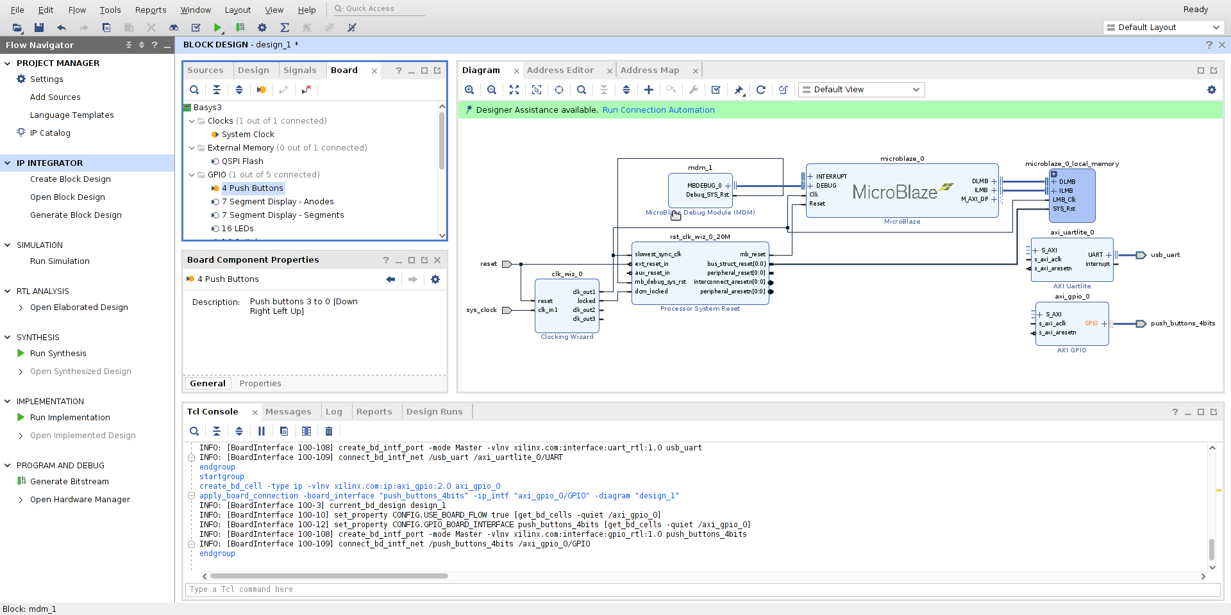
Crowd Supply: Lab One
Lab One
Step 16 – From the boards tab drag and drop the 4 Push Buttons onto block diagram

Slide 24
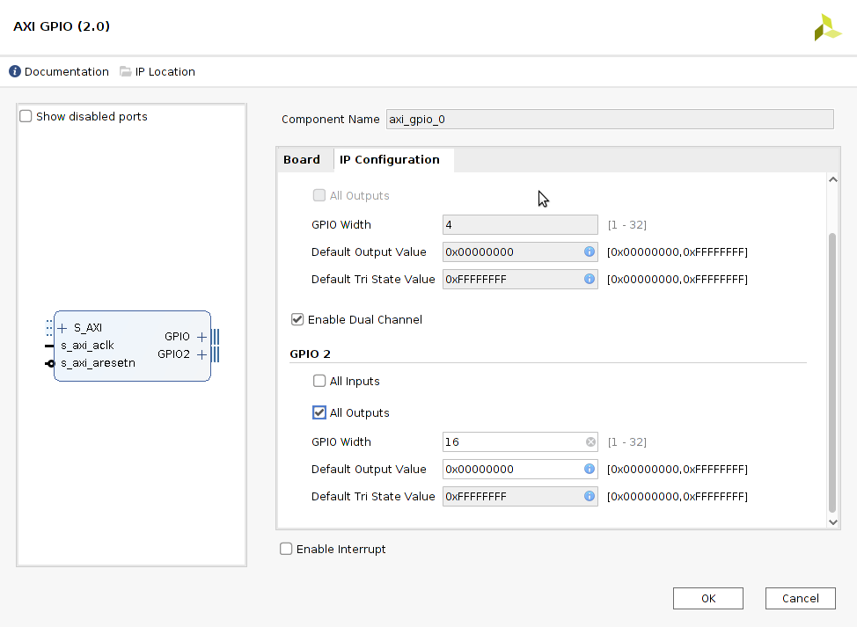
Crowd Supply: Lab One
Lab One
Step 17 – Double click on the GPIO IP Block and re-customize it for a second channel of all outputs and width of 16 bits

Slide 25
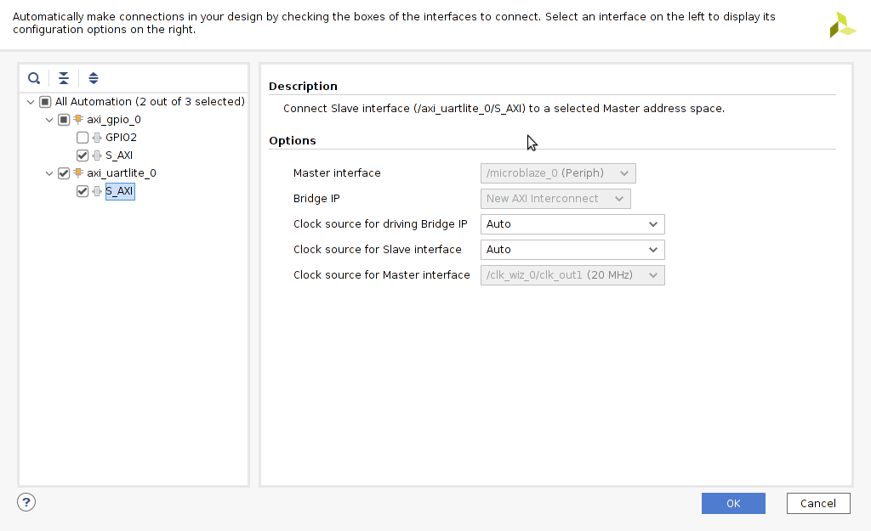
Crowd Supply: Lab One
Lab One
Step 18 – Run the Connection Automation and connect the UART and GPIO S_AXI interfaces to the MicroBlaze

Slide 26
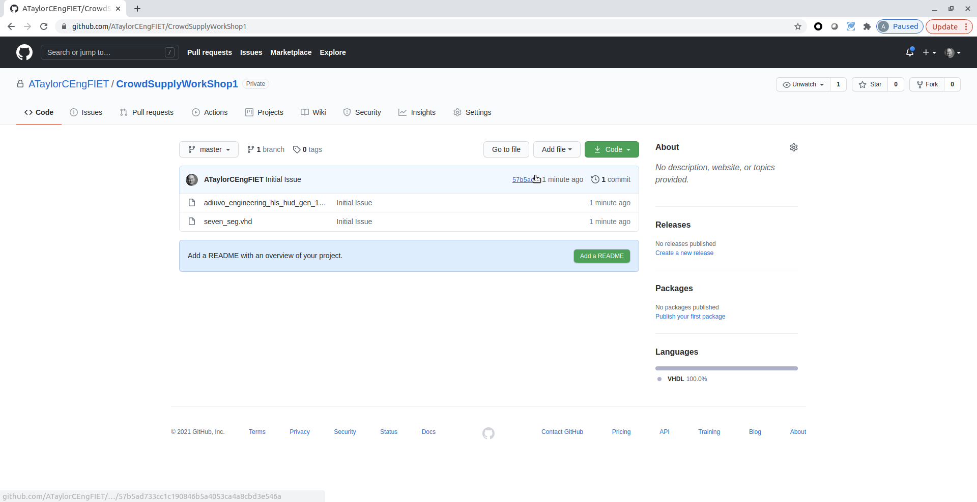
Crowd Supply: Lab One
Lab One
Step 19 – Open a web browser and clone the IP files from the GitHub https://github.com/ATaylorCEngFIET/Crowd SupplyWorkShop1

Slide 27
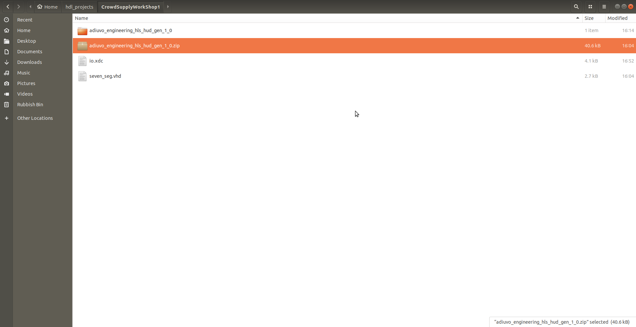
Crowd Supply: Lab One
Lab One
Step 20 – This will clone three files one RTL File, a XDC constraints and an HLS IP core

Slide 28
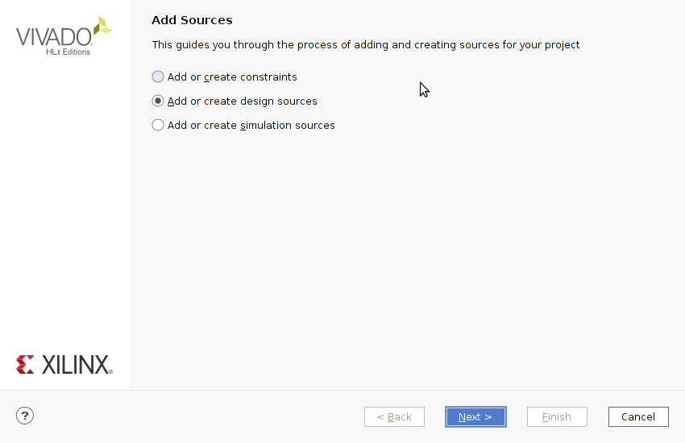
Crowd Supply: Lab One
Lab One
Step 21 – Click on the Add or Create design sources tab and then next

Slide 29
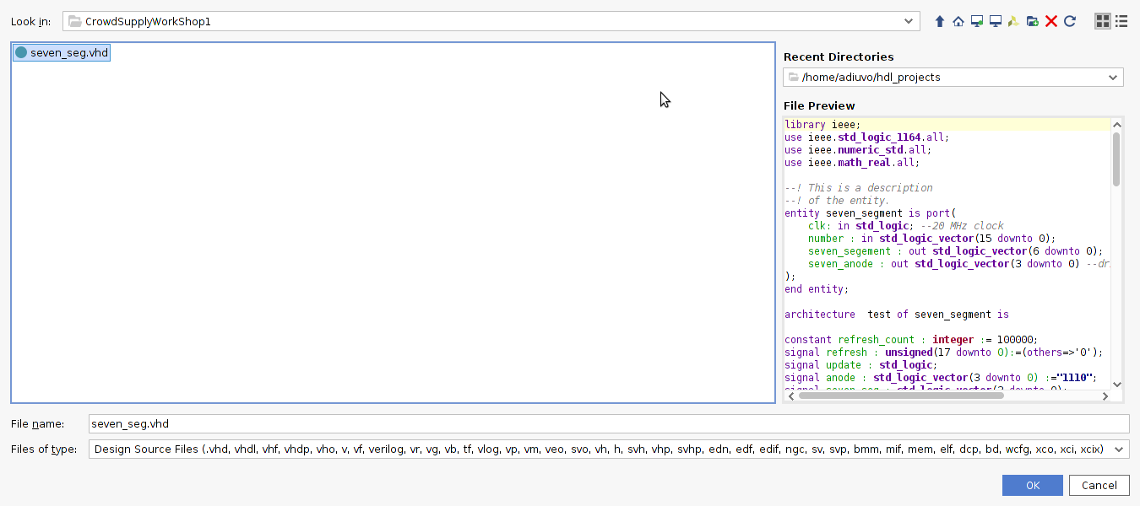
Crowd Supply: Lab One
Lab One
Step 22 – Select the Seven_seg.vhd RTL file

Slide 30
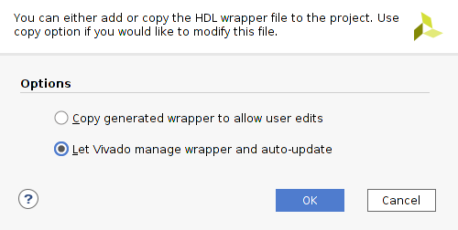
Crowd Supply: Lab One
Lab One
Step 23 – Create an RTL Wrapper for the block diagram, by right clicking on the block diagram icon. In the dialog which pops up let Vivado Manage the wrapper. Click OLK

Slide 31
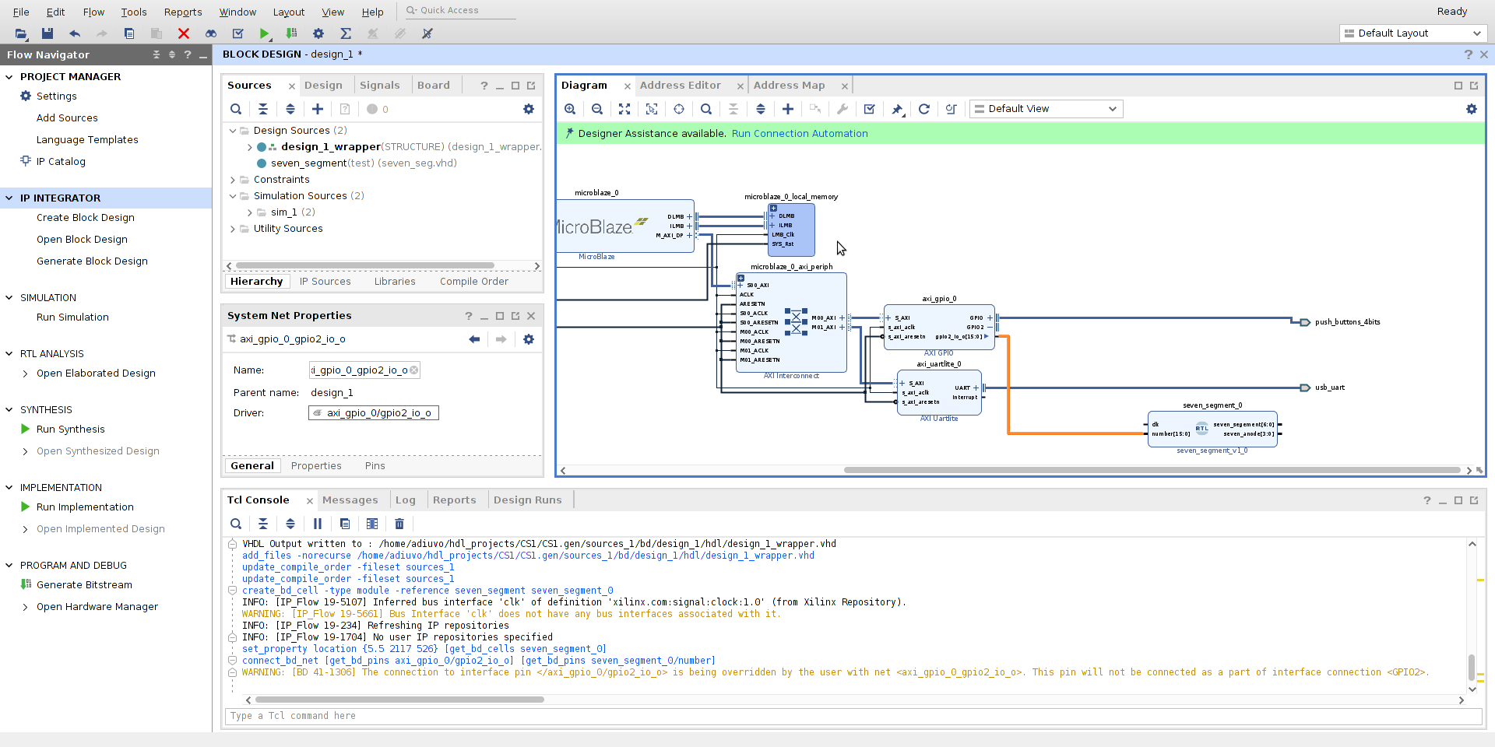
Crowd Supply: Lab One
Lab One
Step 24 – Drag the Seven Seg RTL block onto the block diagram and connect the second output port from the GPIO IP to the input of the Seven Segment Input

Slide 32
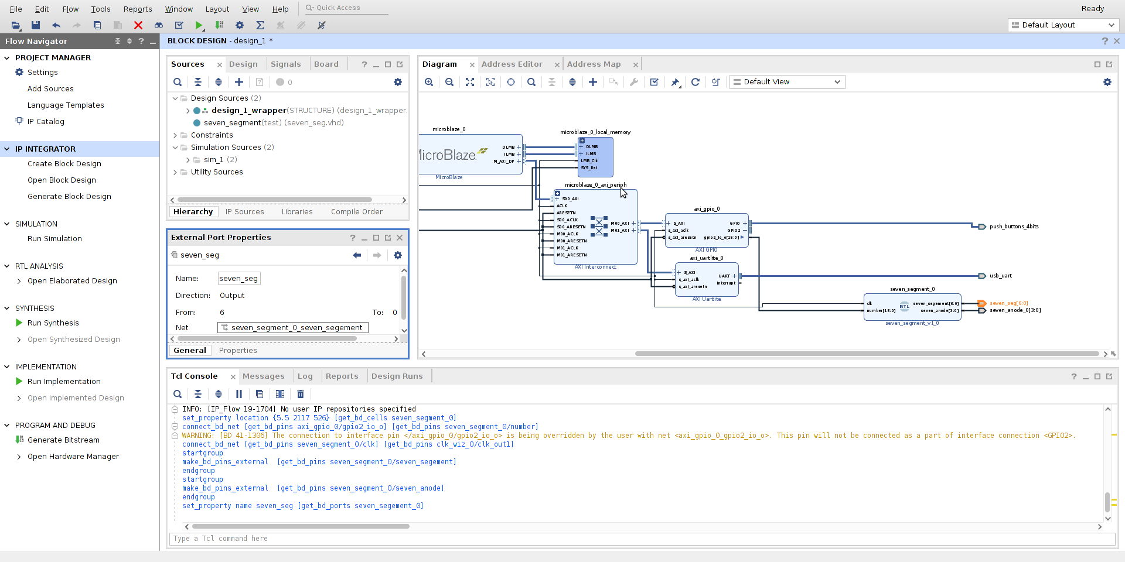
Crowd Supply: Lab One
Lab One
Step 25 – Connect the clock of the Seven Segment to clock 1 (20 MHZ) and make the two ports external – Name them seven_seg & seven_seg_led_an

Slide 33
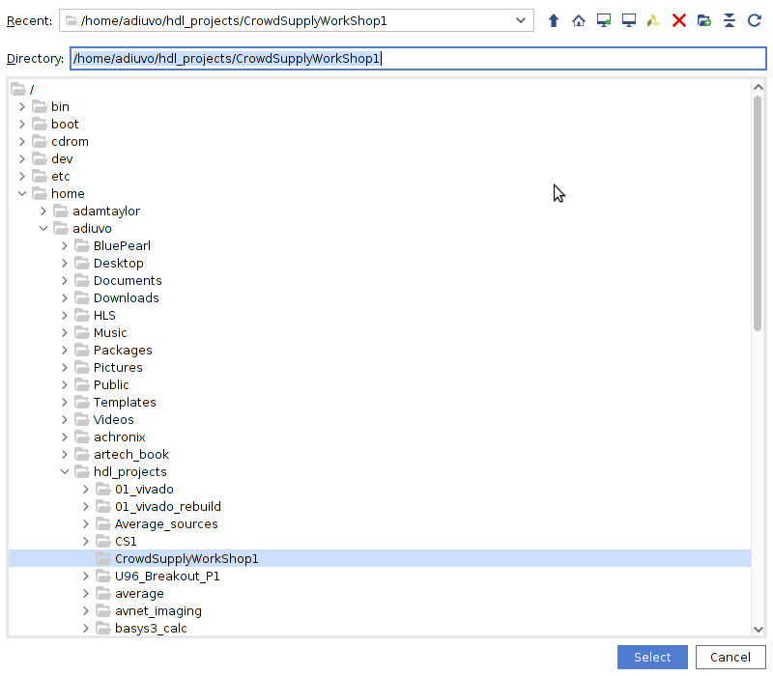
Crowd Supply: Lab One
Lab One
Step 26 – Open the IP library, right click and select add repository – Select the Cloned Repository as the location

Slide 34
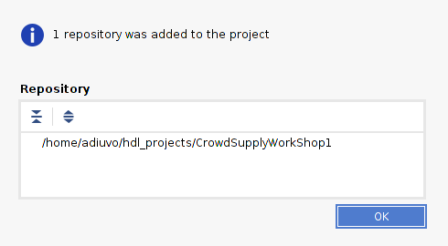
Crowd Supply: Lab One
Lab One
Step 27 – This will add one repository to the project as shown by the dialog, click OK

Slide 35
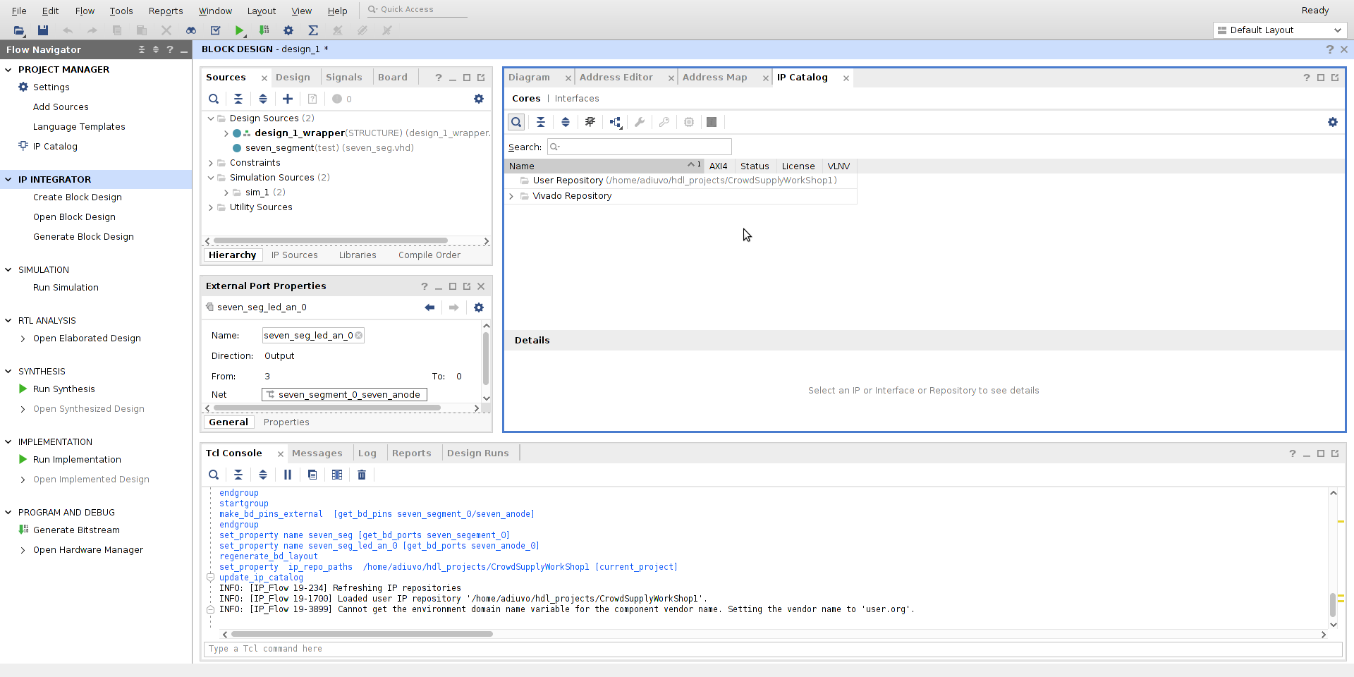
Crowd Supply: Lab One
Lab One
Step 28 – Right click on the user repository and select add IP to repository

Slide 36
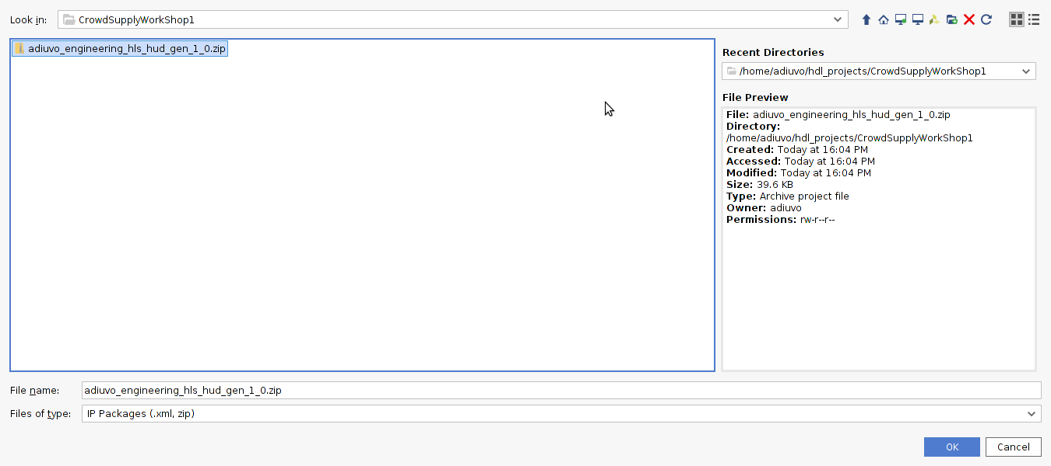
Crowd Supply: Lab One
Lab One
Step 29 – Select the zip in the cloned directory

Slide 37
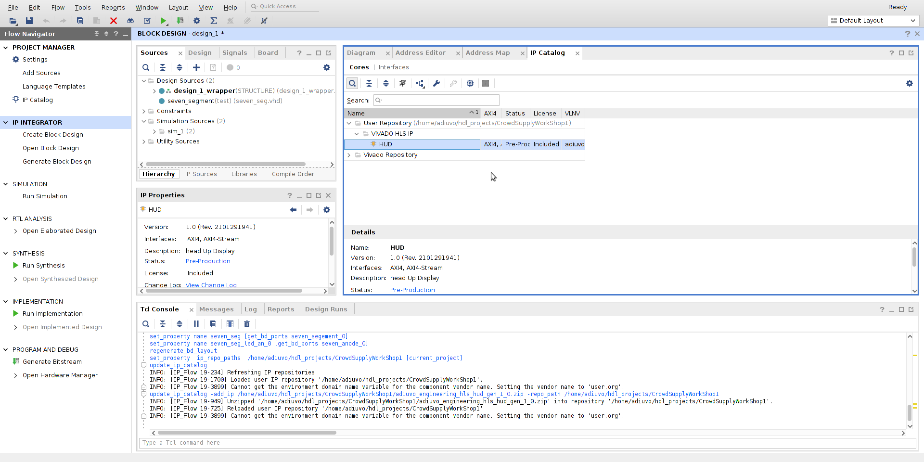
Crowd Supply: Lab One
Lab One
Step 30 – Under the User Repository you should now see the HUD IP Block

Slide 38
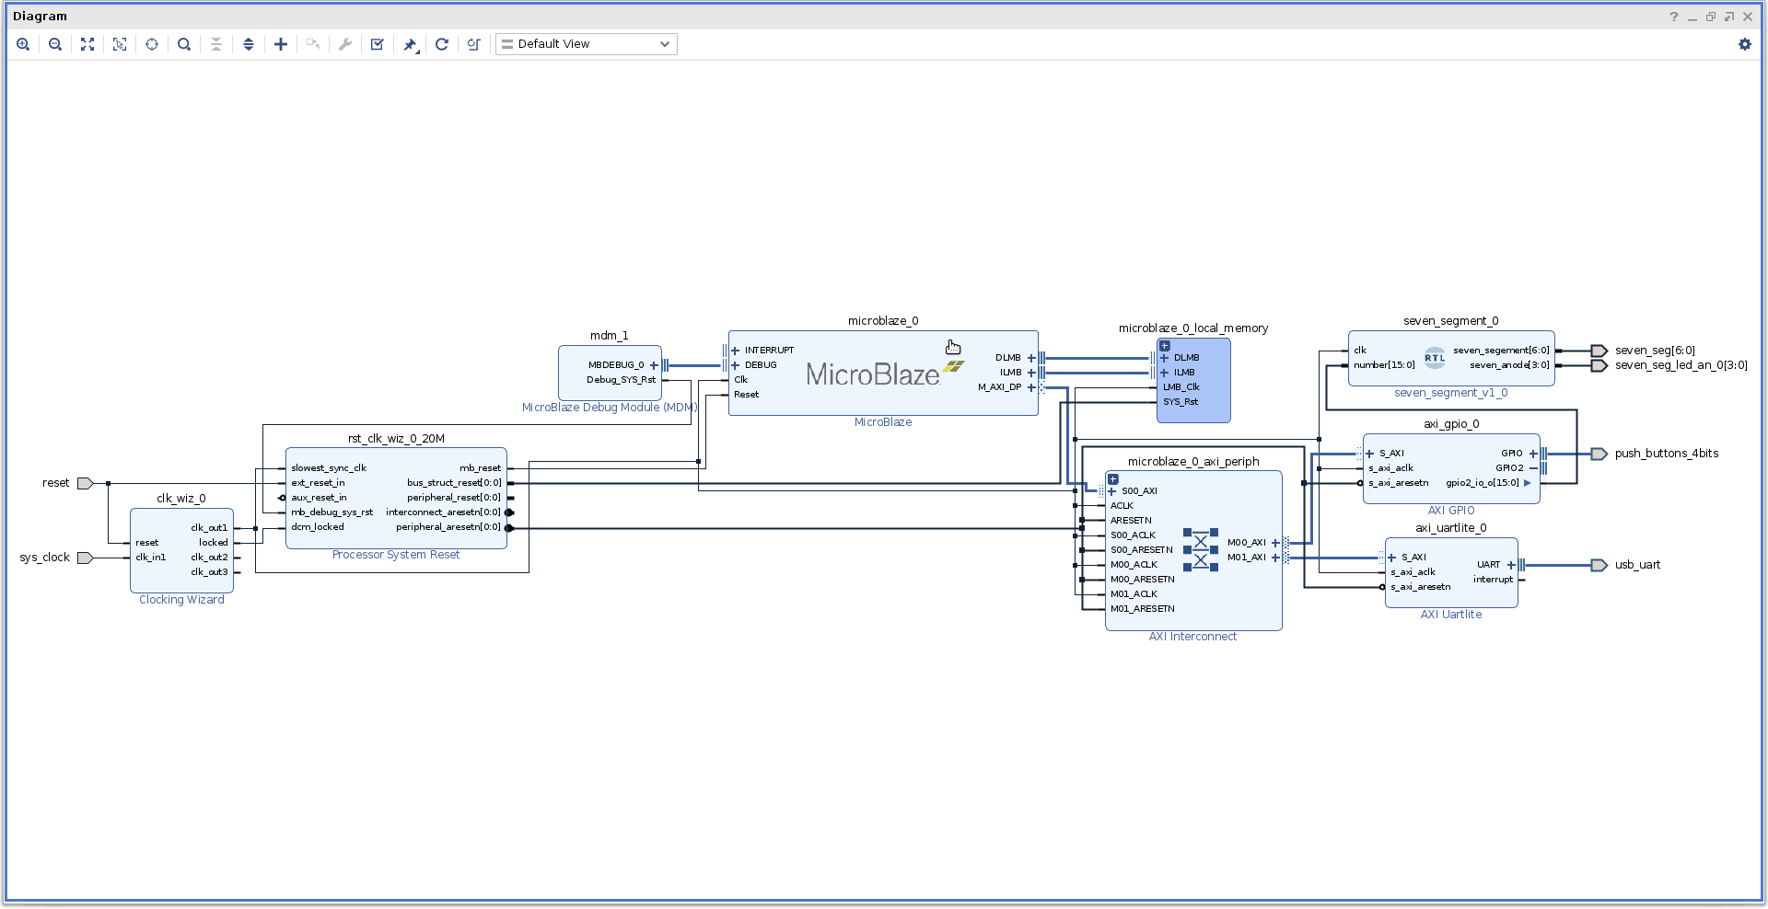
Crowd Supply: Lab One
Lab One
Step 31 – Float the block diagram and maximize the window

Slide 39
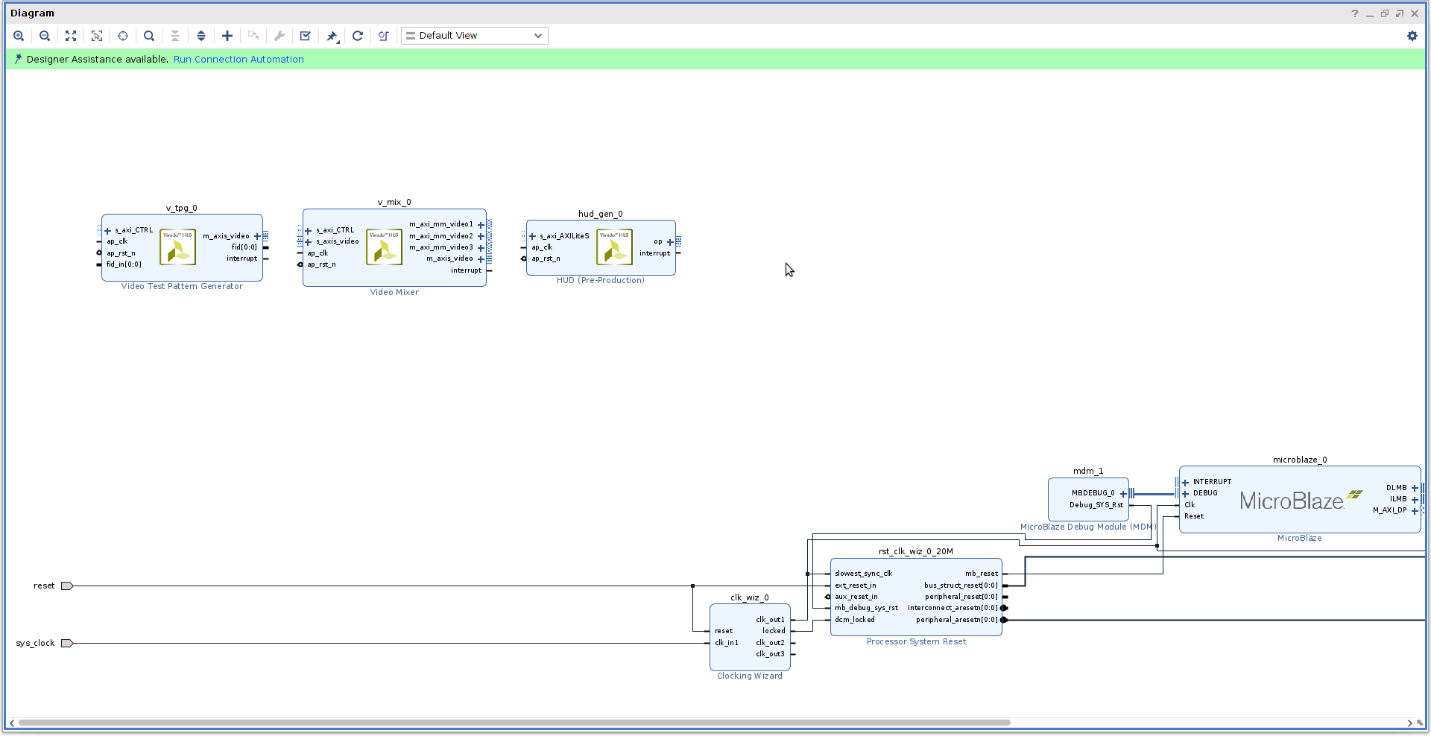
Crowd Supply: Lab One
Lab One
Step 32 – Use the + Symbol to add in the Test Pattern Generator, Video Mixer and HUD

Slide 40
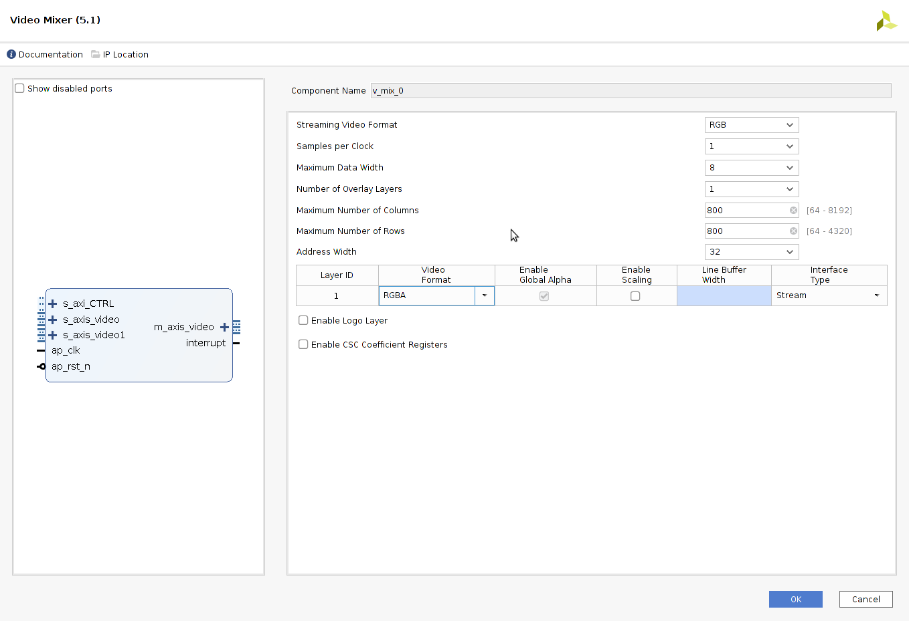
Crowd Supply: Lab One
Lab One
Step 33 – Double click on the Video Mixer and configure it as below

Slide 41
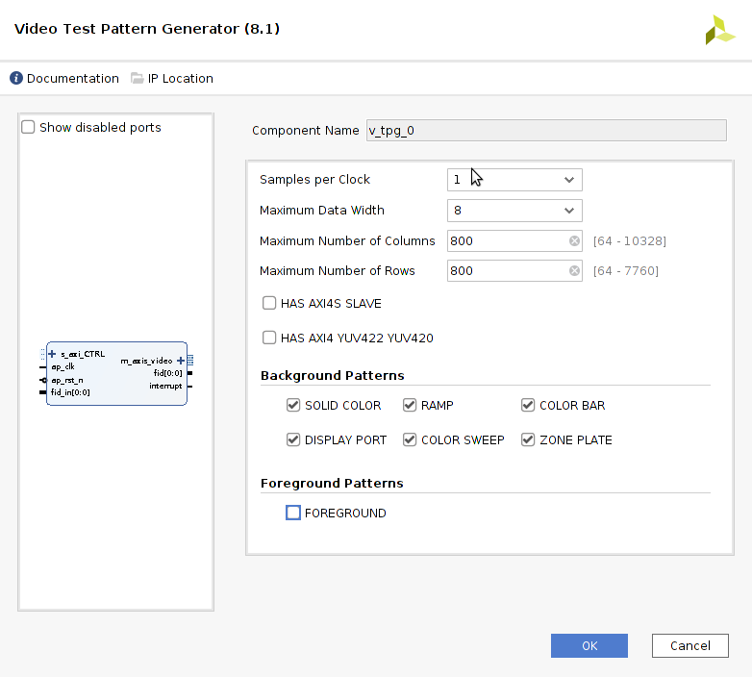
Crowd Supply: Lab One
Lab One
Step 34 – Double click on the Test Pattern Generator and configure it as below

Slide 42
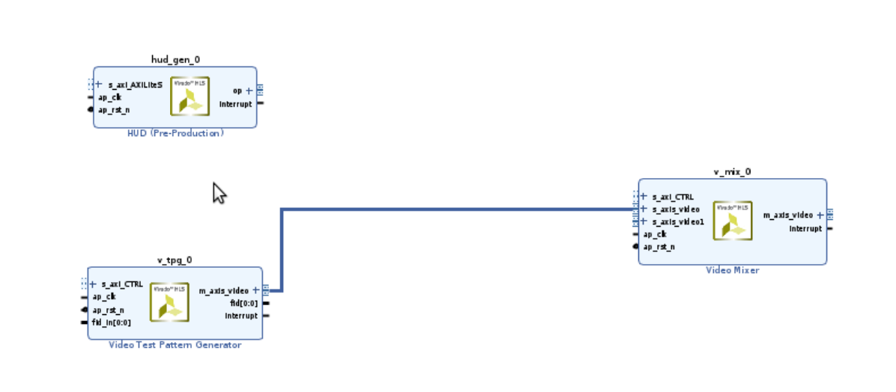
Crowd Supply: Lab One
Lab One
Step 35 – Connect the Test Pattern Generator to the Stream Video in on the Video Mixer

Slide 43
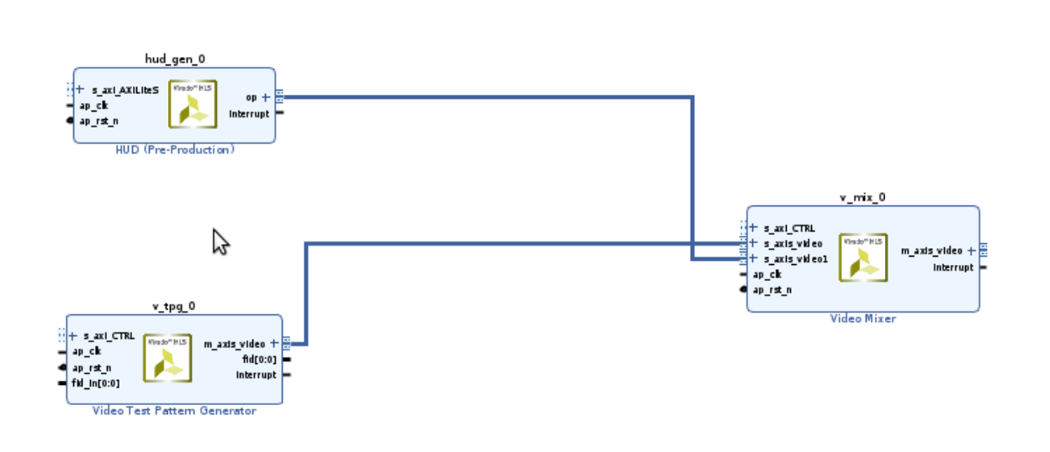
Crowd Supply: Lab One
Lab One
Step 36 – Connect the HUD OP to Stream AXIS Video 1 on the Video Mixer

Slide 44
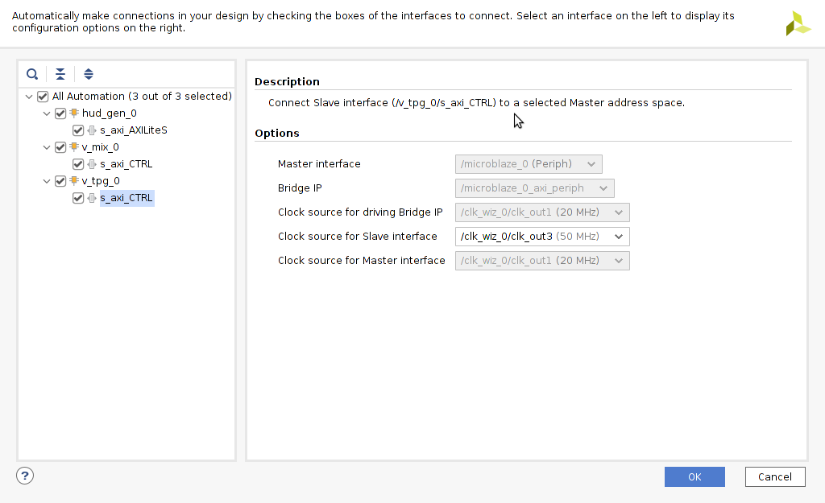
Crowd Supply: Lab One
Lab One
Step 37 – Run the connection automation and for all three modules select the clock wizard OP3 50MHz

Slide 45
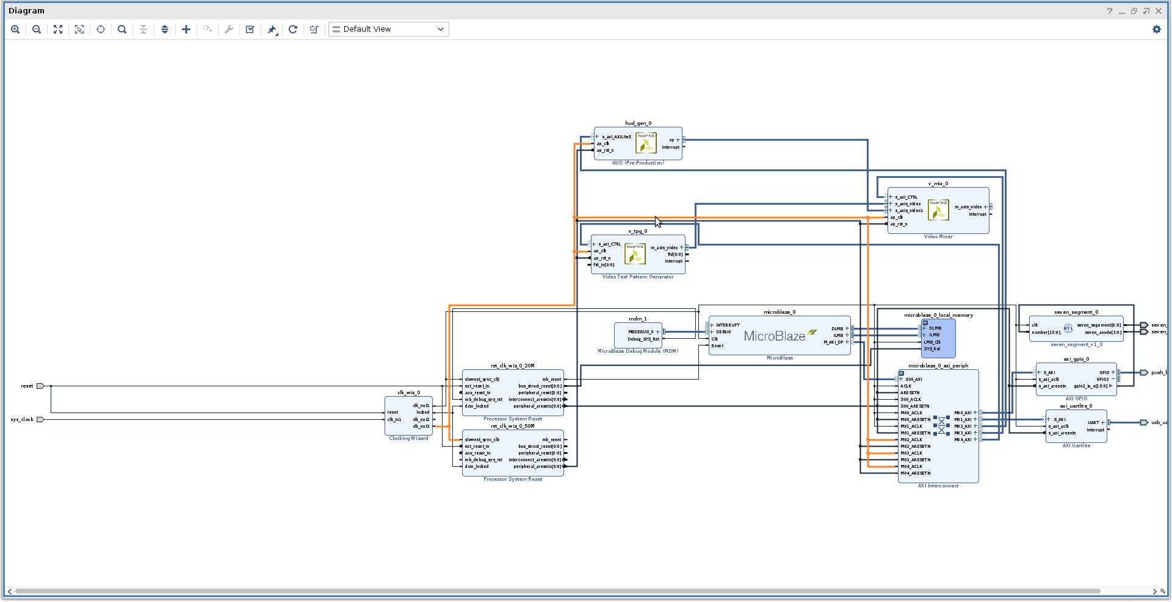
Crowd Supply: Lab One
Lab One
Step 38 – Check the Clock network to the HUD, TPG and Vmixer and AXI Network are 50MHz

Slide 46
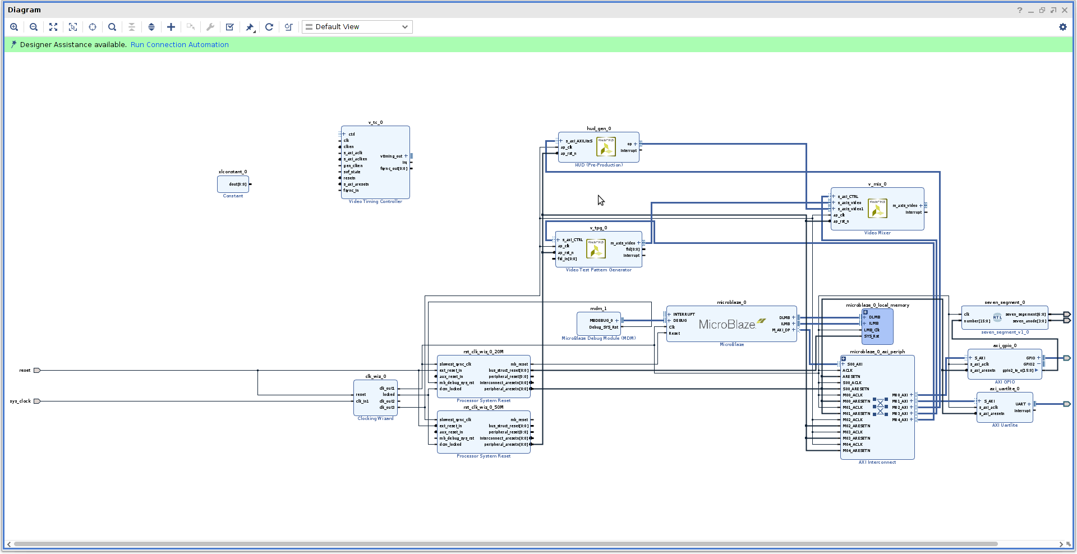
Crowd Supply: Lab One
Lab One
Step 39 – Use the + button to add in a Video Timing Generator and Constant block

Slide 47
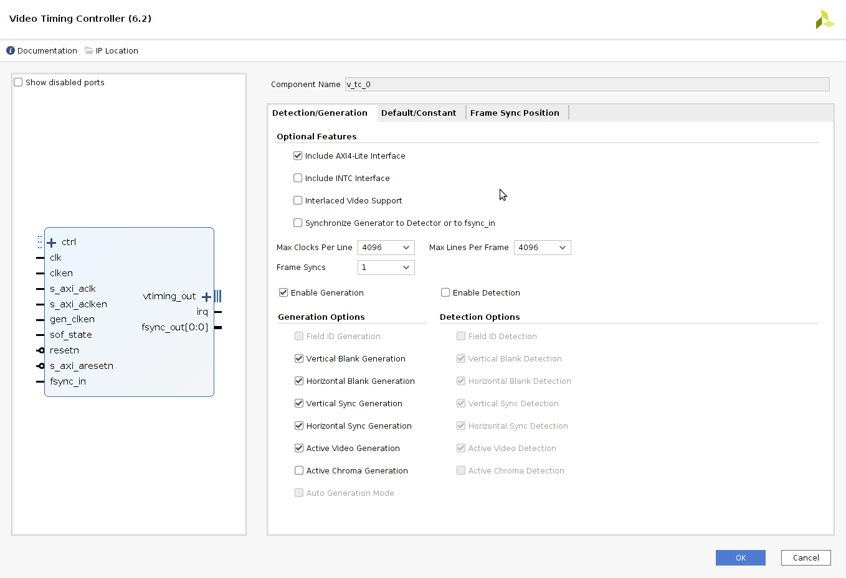
Crowd Supply: Lab One
Lab One
Step 40 – Double click the Video Timing Controller on it to re-customise – as shown below

Slide 48
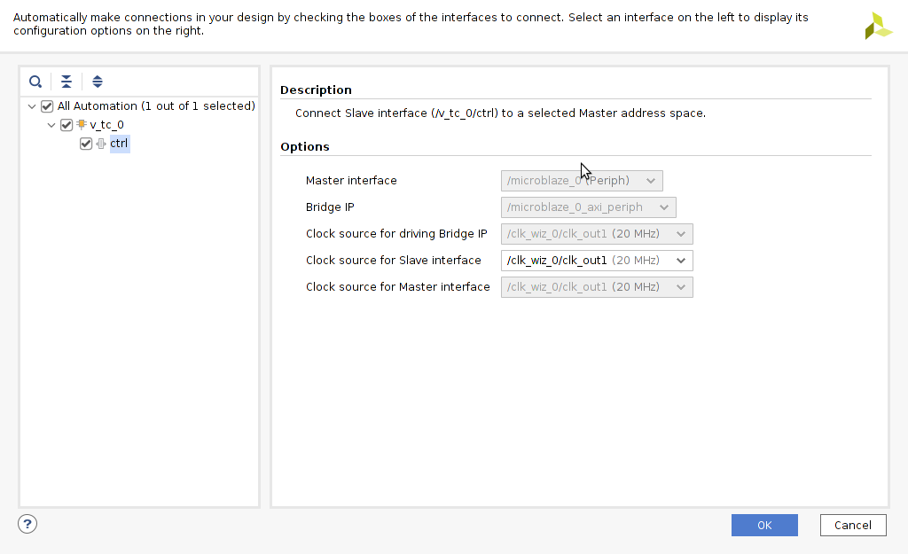
Crowd Supply: Lab One
Lab One
Step 41 – Run the connection automation to connect the VTC into the AXI Network – Ensure the clock is Clock 1 20MHz

Slide 49
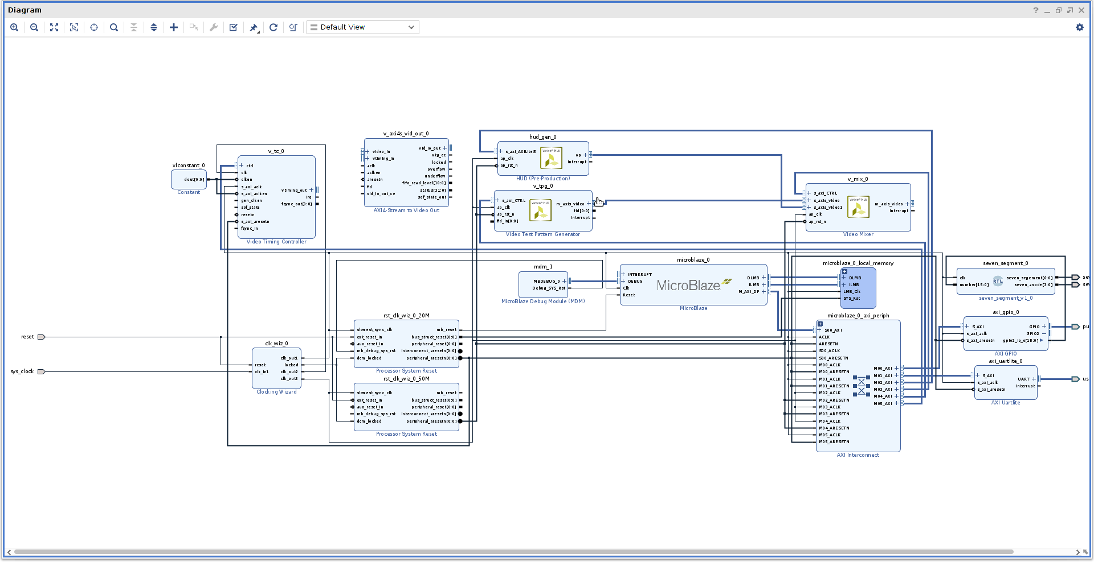
Crowd Supply: Lab One
Lab One
Step 42 – Add in a AXI Stream to Video Out IP block

Slide 50
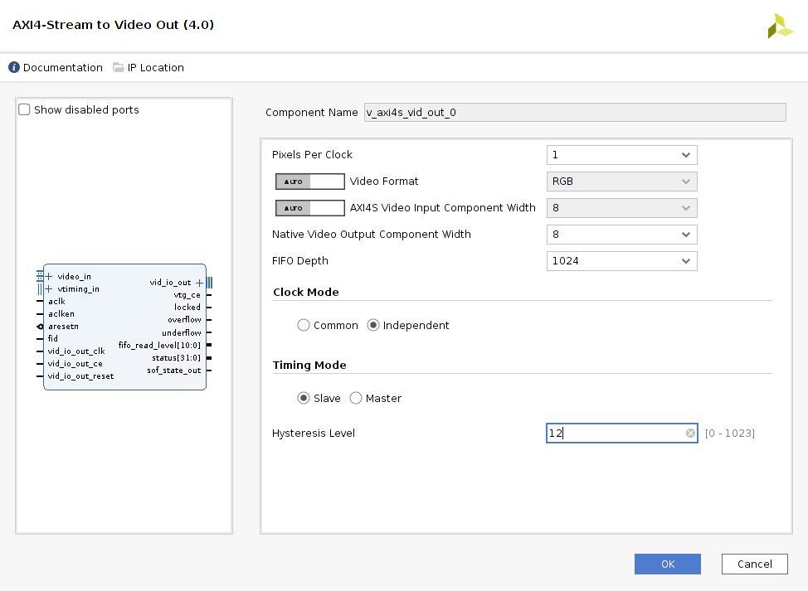
Crowd Supply: Lab One
Lab One
Step 43 – Double click to re-cusomtise the AXI Stream to video out block and configure it as below

Slide 51
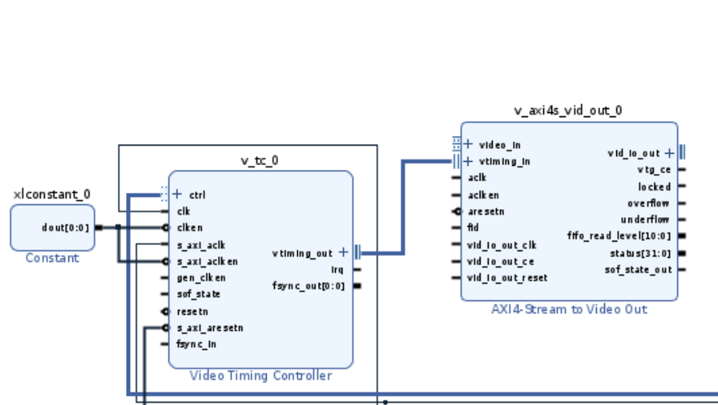
Crowd Supply: Lab One
Lab One
Step 44 – Connect the Vtiming Out to the Vtiming In of the VTC and AXIS to Video Out

Slide 52
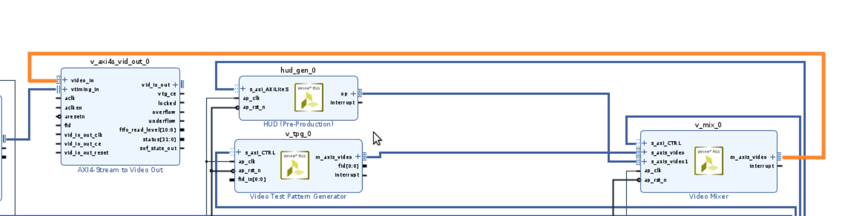
Crowd Supply: Lab One
Lab One
Step 45 – Connect the output of the Video Mixer to the AXIS Video Out Input

Slide 53
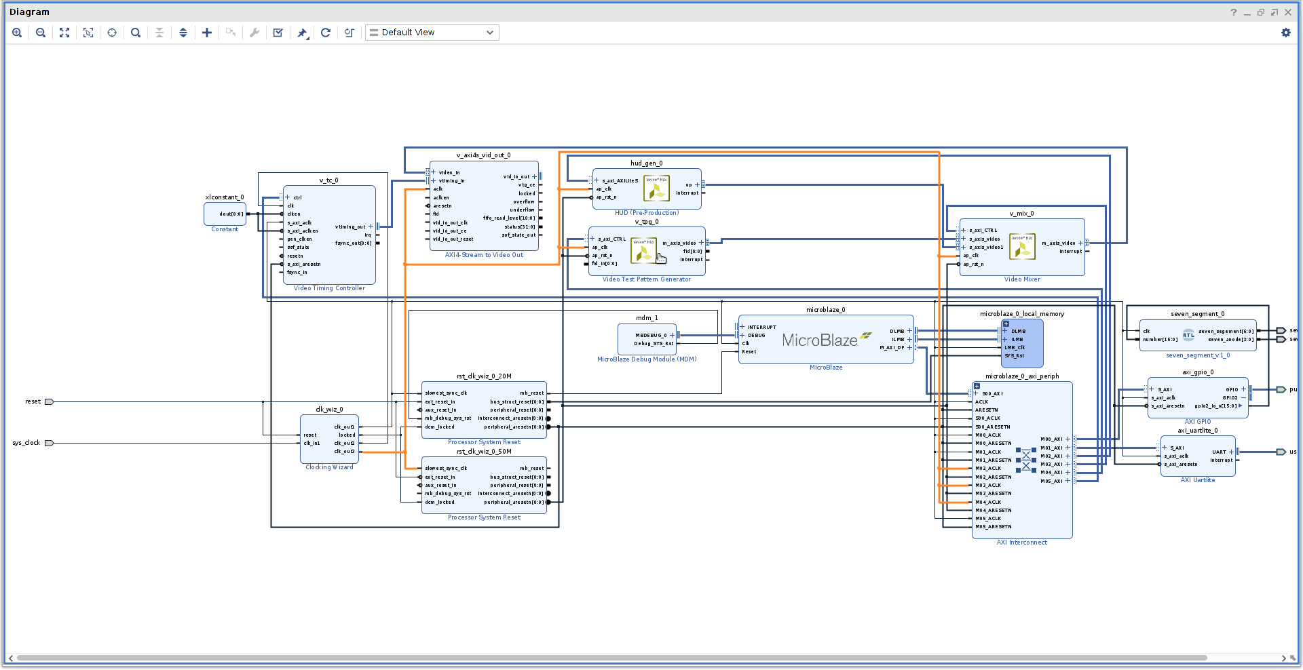
Crowd Supply: Lab One
Lab One
Step 46 – Connect the clock out 3 to the aclk of the AXIS Video Out IP Block

Slide 54
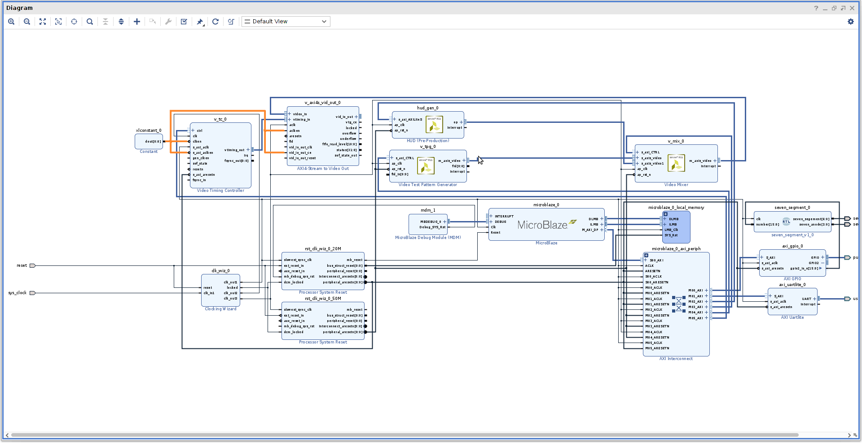
Crowd Supply: Lab One
Lab One
Step 47 – Connect the constant block to the VTC clken & SAXI_aclk_en and aclken & vid_io_out_ce on the AXIS video out

Slide 55
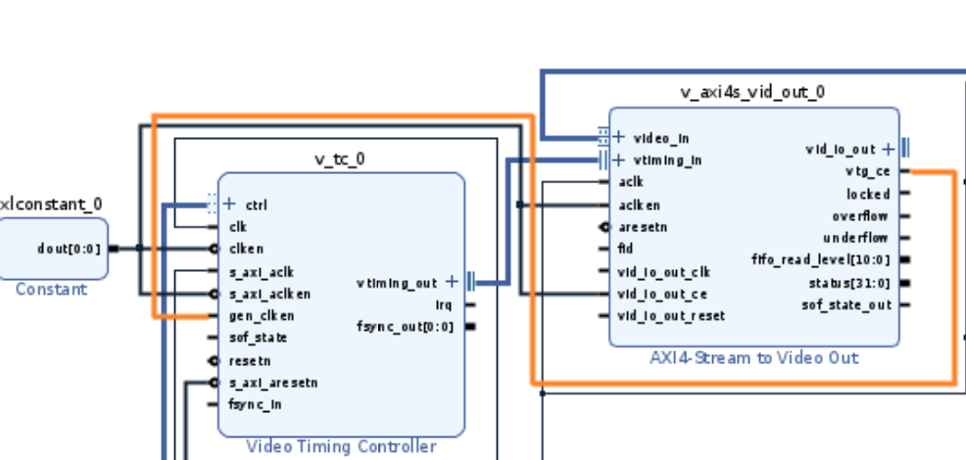
Crowd Supply: Lab One
Lab One
Step 48 – Connect vtg_ce to gen_clken

Slide 56
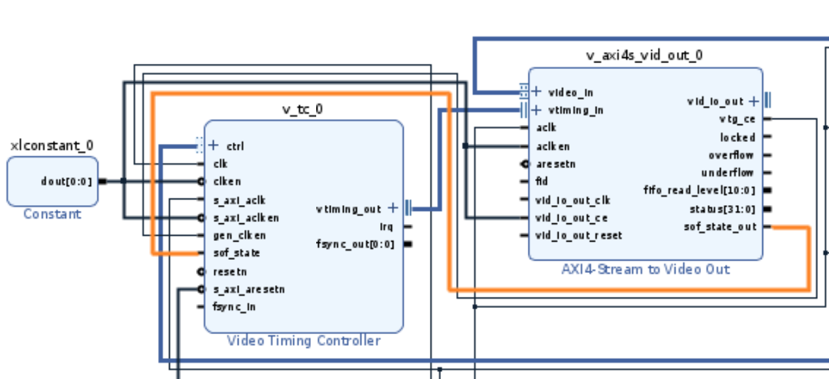
Crowd Supply: Lab One
Lab One
Step 49 – Connect sof_state_out to sof_state

Slide 57
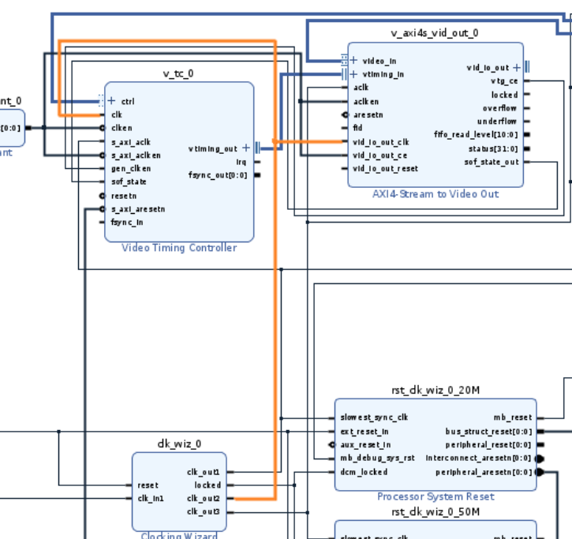
Crowd Supply: Lab One
Lab One
Step 50 – Connect Clock 2 (25MHz) to the clk of the VTC and vid_io_out_clk on the AXIS video out

Slide 58

Crowd Supply: Lab One
Lab One
Step 51 – Click on regenerate layout to make the diagram more understandable

Slide 59

Crowd Supply: Lab One
Lab One
Step 52 – Expand the vid_io_out on the AXIS Video Out block

Slide 60

Crowd Supply: Lab One
Lab One
Step 53 – Make the Vid_hsync external and re-name it Hsync

Slide 61

Crowd Supply: Lab One
Lab One
Step 54 – Make the Vid_vsync external and re-name it Vsync

Slide 62

Crowd Supply: Lab One
Lab One
Step 55 – Add in three slices and connect them to the Vid_data output

Slide 63

Crowd Supply: Lab One
Lab One
Step 56 – Re-customize Slice 0 with the settings as below

Slide 64

Crowd Supply: Lab One
Lab One
Step 57 – Re-customize Slice 1 with the settings as below

Slide 65

Crowd Supply: Lab One
Lab One
Step 58 – Re-customize Slice 2 with the settings as below

Slide 66

Crowd Supply: Lab One
Lab One
Step 59 – Make the Three Slice outputs external name them Slice0 vgaRed, Slice1 vgaBlue and Slice2 vgaGreen

Slide 67

Crowd Supply: Lab One
Lab One
Step 60 – Add in a New processor reset block and connect its clock input to clock 2

Slide 68

Crowd Supply: Lab One
Lab One
Step 61 – Connect the DCM locked signal

Slide 69

Crowd Supply: Lab One
Lab One
Step 62 – Connect the Reset signal to the ext_reset_in of the new processor reset block

Slide 70

Crowd Supply: Lab One
Lab One
Step 63 – Connect the peripheral_aresetn from the reset block to the VTC resetn

Slide 71

Crowd Supply: Lab One
Lab One
Step 64 – Connect the peripheral_areset from the reset block to the AXIS Video Out vid_in_out_reset

Slide 72

Crowd Supply: Lab One
Lab One
Step 65 – Connect the peripheral_areset from the reset block associated with the clock 3 (50 Mhz) with the AXIS Video out aresetn input

Slide 73

Crowd Supply: Lab One
Lab One
Step 66 – Validate the design, we should see no errors or warnings

Slide 74

Crowd Supply: Lab One
Lab One
Step 67 – Add in a new constraints source and select the IO constraints from the github repo

Slide 75

Crowd Supply: Lab One
Lab One
Step 68 – The final block design should look as below

Slide 76

Crowd Supply: Lab One
Lab One
Step 69 – Click on build the bit stream – If you see the following dialog select yes

Slide 77

Crowd Supply: Lab One
Lab One
Step 70 – Click on build the bit stream – select the number of jobs and click run

